Slide 1




CS-222: Web Technology
Expense Tracker
Presentation for the partial fulfilment of CS-222 course
by
Pratyush Tiwari (22MC3024)
Pushkar Raj (22MC3025)
Course instructor: Dr Gargi Srivastava

Slide 2
Content
01
Problem Description
02
Introduction to Solution
03
Tech Stack Used
04
User Experience
05
User Journey
06
Conclusion

Slide 3

Problem Description
In modern times, the convenience of transactions have improved drastically. This encourages individuals to spend without being concerned of the expenditure. We see a need for a method to track cash outflows to maintain savings.
03

Slide 4


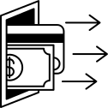


Introduction to Solution
Expense Tracker

Slide 5


TECH STACK USED
MERN Stack
MongoDB
Node.js
Express.js
React.js

Slide 6
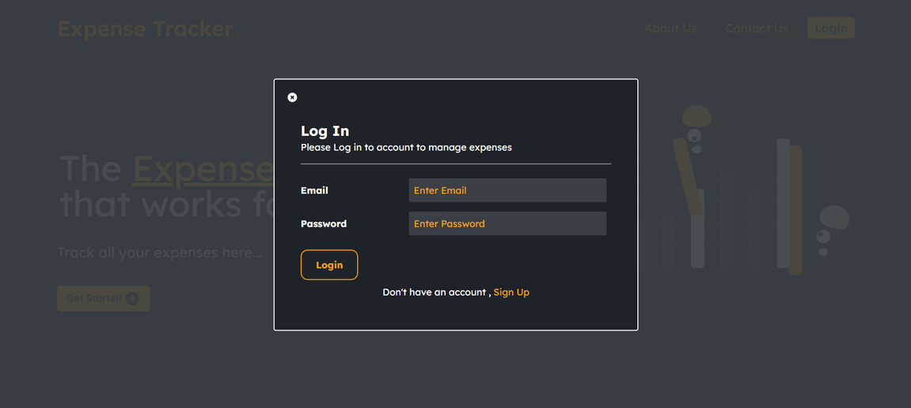
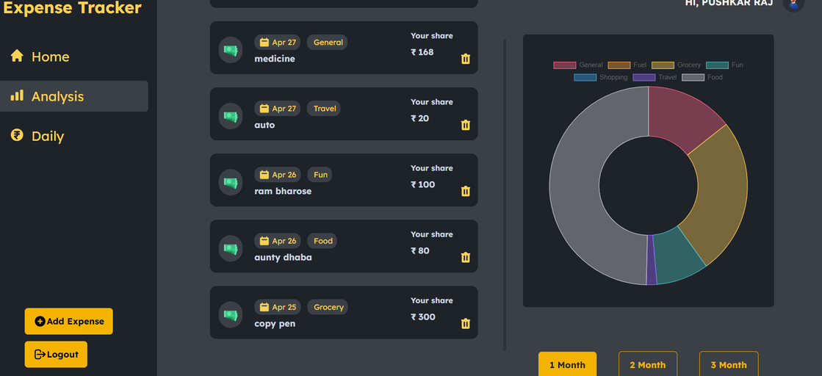
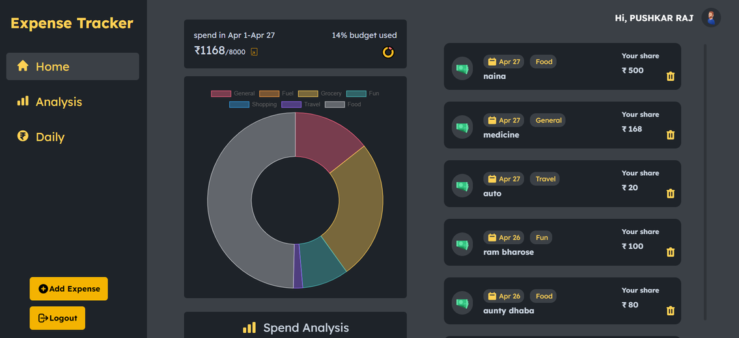
USER EXPERIENCE
Login Page
Monthly Expense Analysis
Dashboard

Slide 7
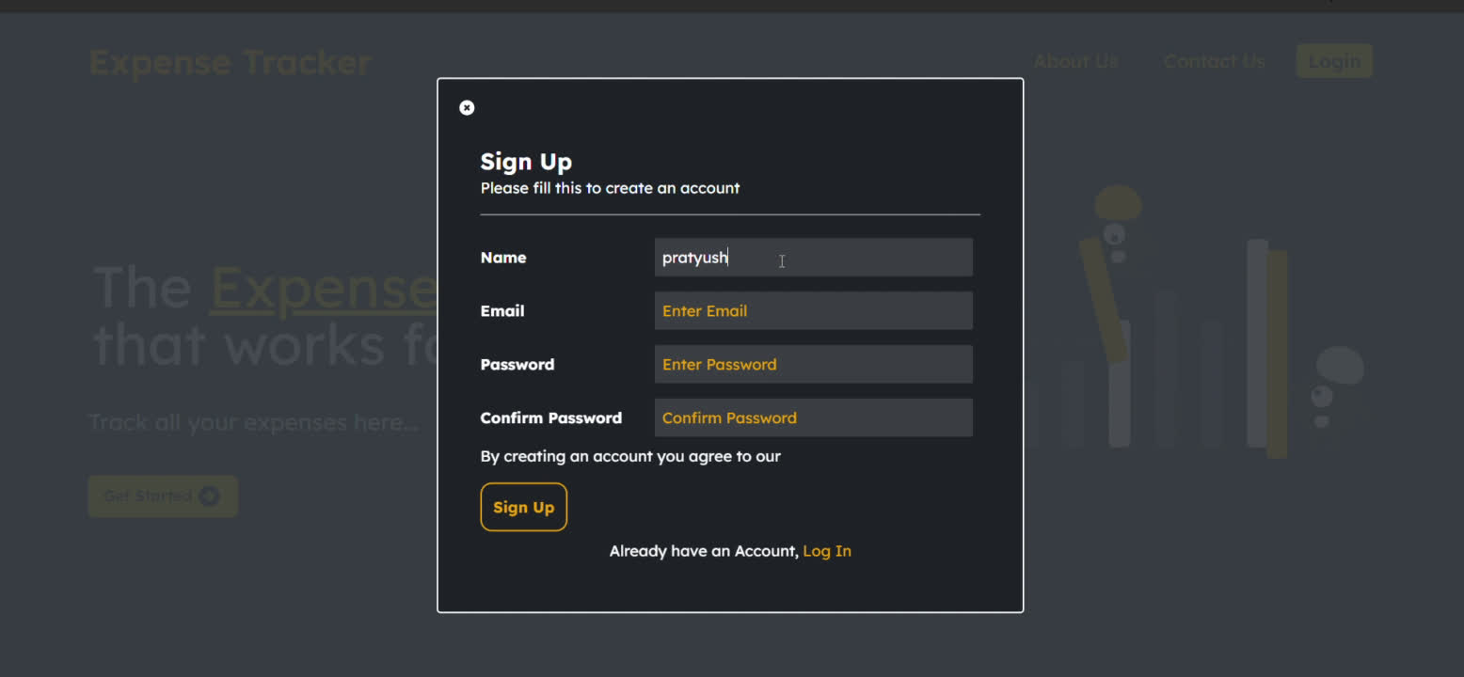
USER JOURNEY

Slide 8

Conclusion
To tackle the issue of excessive spending and enhance our financial management skills, we created an expense tracker by utilizing the MERN stack. This solution tackles the contemporary trend of transaction convenience, which frequently encourages excessive spending. Our MERN-based spending tracker uses technology to give users an easy-to-use platform to track their cash outflows, empowering them to make wise decisions and uphold healthier saving practices. In a world where cash is becoming less and less common, this tool helps users take charge of their finances, resulting in increased financial stability and peace of mind.

Slide 9
THANK YOU!!

